Slide 1
DevSecOps Course v2.0.0
Primary Instructor: CW2 Sean Herbert
Alternate Instructor: CW3 Nick Chadwick

Slide 2
Agenda
What is DevSecOps and the common tools used amongst Engineers.
What vulnerability scans are done to ensure security compliance is meet.
What is DevSecOps working to enable and overall benefits.
Computer networking and API.
More resources.

Slide 3
Instructor Background
How you got started in DevSecOps.
What are you currently doing now.

Slide 4
Why Learn This?
75th Innovation Command is receiving an increased demand to support these kinds of missions.
Significant salary increases – 25% or more.
Anyone who works with software can incorporate DevSecOps within their current organization.
Application containerization.
Automate tasks.
Ensure proper security compliance is being enforced.

Slide 5
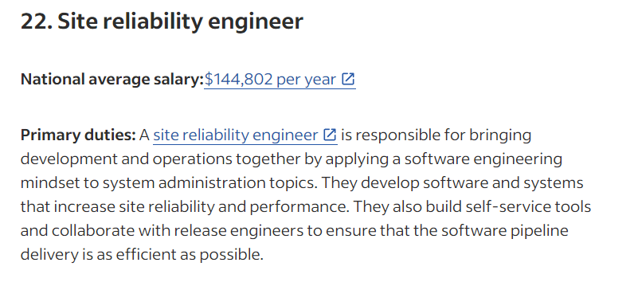
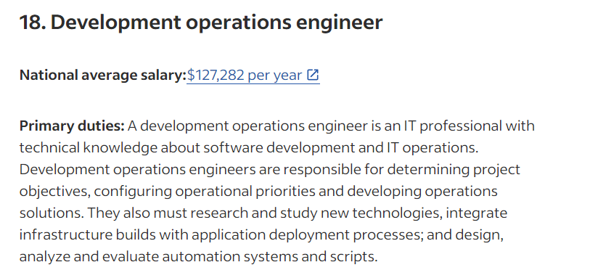
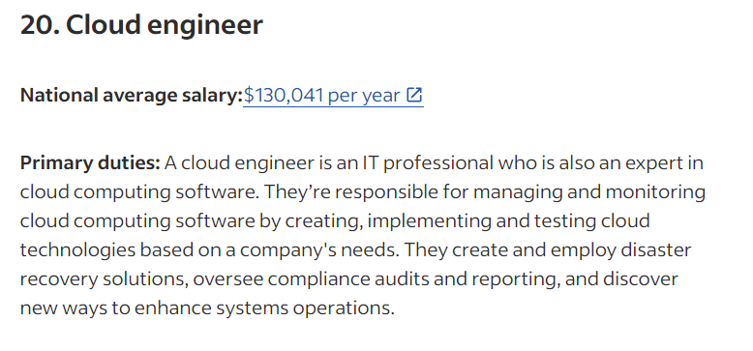
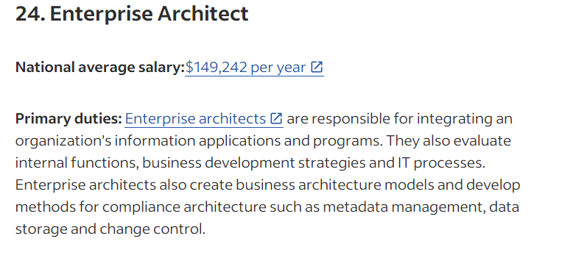
Why become a DevSecOps Engineer?
https://www.indeed.com/career-advice/finding-a-job/top-paying-technology-jobs
Common technical job titles
DevOps Engineer
Cloud Engineer
Site Reliability Engineer
Common technical management job titles
Technical Lead
Architect

Slide 6
What is DevSecOps?
“DevSecOps is a software engineering culture and practice that aims at unifying software development (Dev), security (Sec), and operations (Ops). DevSecOps emphasizes collaboration and communication between development, security, and operations teams to deliver secure and resilient software at the speed of relevance. It involves automating security and testing processes, integrating security tools and practices into the development pipeline, and fostering a culture of shared responsibility for performance and security.” https://www.cloud.mil/devsecops/

Slide 7
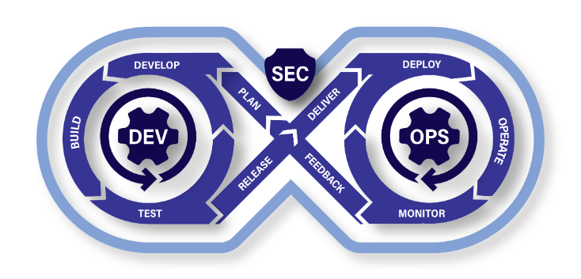
Continuous Integration/ Continuous Deployment (CI/CD)

Slide 8
Key Tools that Enables DevSecOps
Infrastructure as Code (IaC)
“Infrastructure as code (IaC) is the ability to provision and support your computing infrastructure using code instead of manual processes and settings.” https://aws.amazon.com/what-is/iac/
Containerization
“Containerization is a software deployment process that bundles an application’s code with all the files and libraries it needs to run on any infrastructure.” https://aws.amazon.com/what-is/containerization/
Continuous Integration/ Continuous Deployment (CI/CD)
“CI/CD falls under DevOps (the joining of development and operations teams) and combines the practices of continuous integration and continuous delivery. CI/CD automates much or all of the manual human intervention traditionally needed to get new code from a commit into production, encompassing the build, test (including integration tests, unit tests, and regression tests), and deploy phases, as well as infrastructure provisioning.” https://about.gitlab.com/topics/ci-cd/

Slide 9
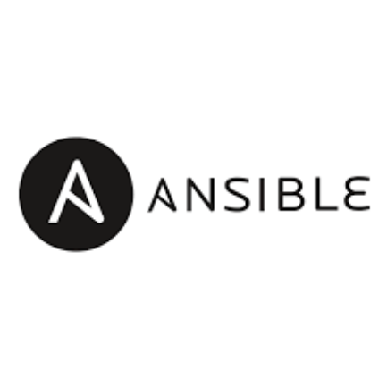
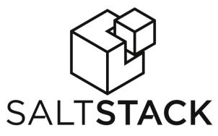

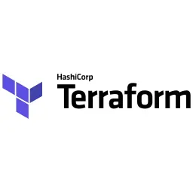
Popular IaC Tools
Persistent – Changes are permanent and remain in effect until manually modified.
Non-persistent – Changes can be automatically reverted or overwritten by IaC tools.

Slide 10
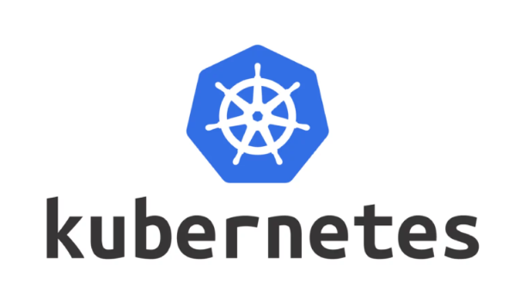

Popular Containerization Tools

Slide 11
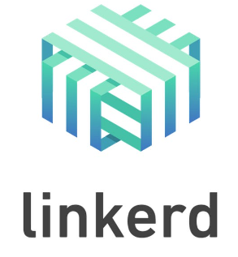


Popular Service Mesh Tools

Slide 12
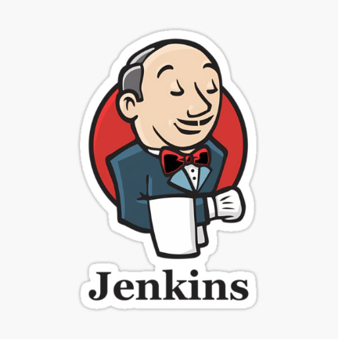
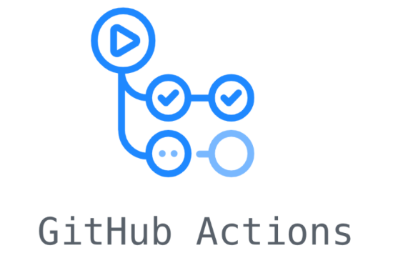

Popular CI/CD Tools

Slide 13
Common Security Vulnerability Tests
Secrets Scanning
Static Analysis Software Test (SAST)
Dynamic Analysis Software Test (DAST)
Container Software Bill of Material (SBOMs)

Slide 14
What is DevSecOps trying to enable?
DevSecOps Platform
Software Factory
Continuous Authority to Operate (cATO)

Slide 15
Overall Benefit
Consistent, repeatable outcomes in testing, vulnerability assessments, and deployments across development, staging, and production environments—enabled by automation.
Collaborative responsibility for delivering software, with shared ownership between developers, DevSecOps engineers, and management.
Significantly accelerated time to ATO (Authority to Operate) through streamlined, automated processes.

Slide 16
What is Site Reliability Engineering?
Ben Treynor https://www.linkedin.com/in/benjamin-treynor-sloss-207120/ began Google Site Reliability Engineering team back in 2003.
Site Reliability Engineering focuses primarily on the reliability of software running in production.
DevSecOps focuses primarily on ensuring strong security compliance is meet before going into production.
https://www.youtube.com/watch?v=n4Wf14e2jxQ

Slide 17
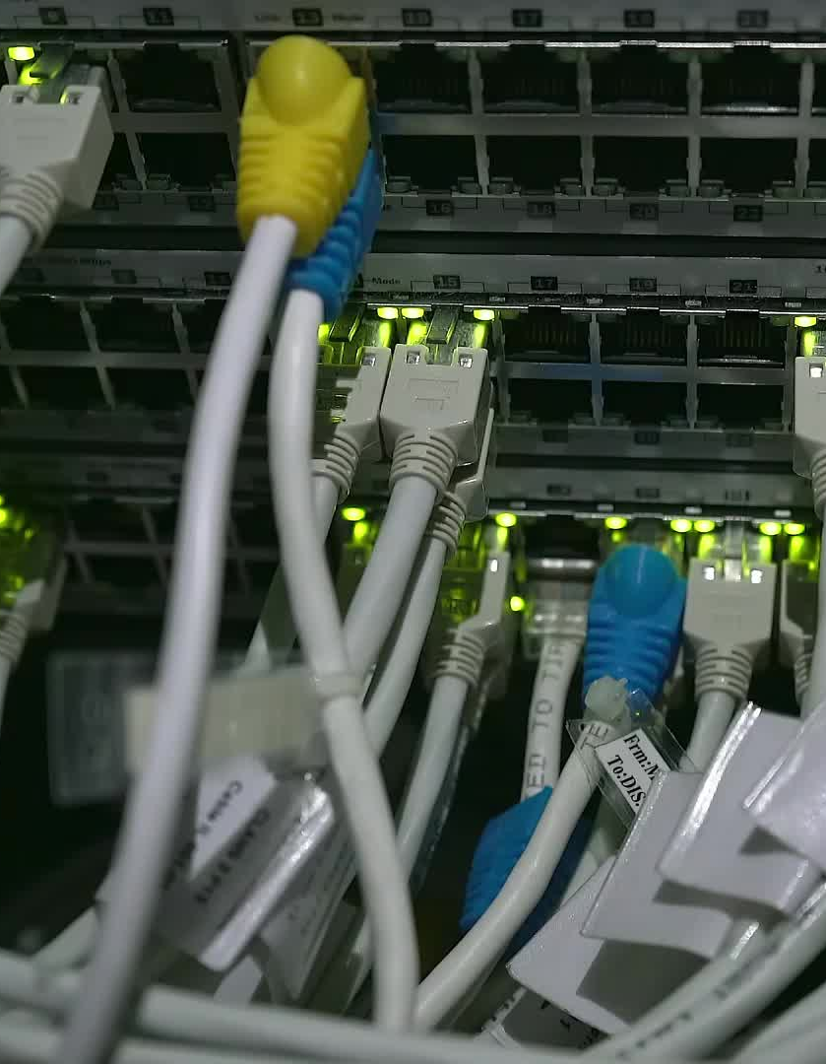
What is a Computer Network?
“Computer networking refers to interconnected computing devices that can exchange data and share resources with each other.” - https://aws.amazon.com/what-is/computer-networking/

Slide 18
What is Domain Name Services (DNS)
Translates human readable domain names (for example, www.amazon.com) to machine readable IP addresses (for example, 192.0.2.44).” - https://aws.amazon.com/route53/what-is-dns/

Slide 19

HTTP Status Codes https://developer.mozilla.org/en-US/docs/Web/HTTP/Reference/Status
Informational response
(100 – 199)
Successful response
(200 – 299)
Redirection message
(300 – 399)
Client error response
(400 – 499)
Server error response
(500 – 599)

Slide 20

HTTP Request Methods https://developer.mozilla.org/en-US/docs/Web/HTTP/Reference/Methods
GET
Requests a representation of the specified resource.
POST
Submits an entity to the specified resource, often causing a change in state or side effects on the server.
PUT
Replaces all current representations of the target resource with the request content.
DELETE
Deletes the specified resource.
PATCH
Applies partial modifications to a resource.

Slide 21

What is an Application Programming Interface (API) and REST API
“APIs are mechanisms that enable two software components to communicate with each other using a set of definitions and protocols.” - https://aws.amazon.com/what-is/api/
“REST stands for Representational State Transfer. REST defines a set of functions like GET, PUT, DELETE, etc. that clients can use to access server data. Clients and servers exchange data using HTTP.” - https://aws.amazon.com/what-is/api/

Slide 22
API Endpoint

Slide 23
More Resources
Department of Defense DevSecOps Playbook
https://dodcio.defense.gov/Portals/0/Documents/Library/DoD%20Enterprise%20DevSecOps%20Fundamentals%20v2.5.pdf
Learning DevSecOps (Don’t expect a high paying salary without investing into your education)
https://kodekloud.com/
https://engineer.kodekloud.com/
Contribute or use Cloud Native tools within your organization
https://www.cncf.io/

